Slide 1
Record based logical models
16

Slide 2
Contents
Relational model
Network model
Hierarchical model

Slide 3
Record based logical models
Record based models used in describing data at the logical and view levels. But in contrast to the object-based data models, they revolve around the records of the database and specify the overall structure of the database with the help of values.
The three most widely accepted models are
(a) Relational model (b)Network model (c) Hierarchical model

Slide 4
Relational model
Relational Model (RM) represents the database as a collection of relations. A relation is nothing but a table of values. Every row in the table represents a collection of related data values. These rows in the table denote a real-world entity or relationship.
The table name and column names are helpful to interpret the meaning of values in each row. The data are represented as a set of relations. In the relational model, data are stored as tables. However, the physical storage of the data is independent of the way the data are logically organized.

Slide 5
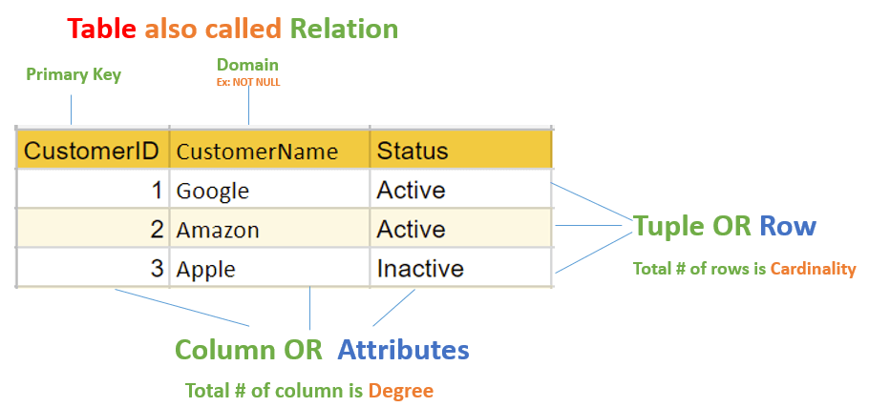
Relational model

Slide 6
Relational model
Attribute: Each column in a Table. Attributes are the properties which define a relation. e.g., Student_Rollno, NAME,etc.
Tables – In the Relational model the, relations are saved in the table format. It is stored along with its entities. A table has two properties rows and columns. Rows represent records and columns represent attributes.
Tuple – It is nothing but a single row of a table, which contains a single record.
Relation Schema: A relation schema represents the name of the relation with its attributes.
Degree: The total number of attributes which in the relation is called the degree of the relation.
Cardinality: Total number of rows present in the Table.
Column: The column represents the set of values for a specific attribute.
Relation instance – Relation instance is a finite set of tuples in the RDBMS system. Relation instances never have duplicate tuples.
Relation key - Every row has one, two or multiple attributes, which is called relation key.
Attribute domain – Every attribute has some pre-defined value and scope which is known as attribute domain

Slide 7
Advantages and Disadvantages
Advantages
Simple
Database design maintenance is easy
Structural independence
Stronger query capability
Disadvantages
Hardware overhead
Ease of design can lead to bad design

Slide 8
Commonly used RDBMS
Asql
Csql
Firebird
IBMDB2
MS SQL Server
MY SQL
Oracle
Informix
Ingress
Microsoft Access

Slide 9
Network Model
A network model is a database model that is designed as a flexible approach to representing objects and their relationships. A unique feature of the network model is its schema, which is viewed as a graph where relationship types are arcs and object types are nodes.
Unlike other database models, the network model's schema is not confined to be a lattice or hierarchy; the hierarchical tree is replaced by a graph, which allows for more basic connections with the nodes.

Slide 10
Network Model
Charles Bachman was the original inventor of the network model. In 1969, the Conference on Data Systems Languages (CODASYL) Consortium developed the network model into a standard specification. A second publication was introduced in 1971, which later turned into the basis for virtually all implementations. It was widely supplanted by the Relational Model later on because of its higher-level, more declarative interface.
The main advantage of the network model is the ability to address the lack of flexibility of the hierarchical model, of which it is supposed to be a direct evolution. In the network model, each child (called “member”) can have more than one parent (called “owner”) to generate more complex, many-to-many relationships.

Slide 11
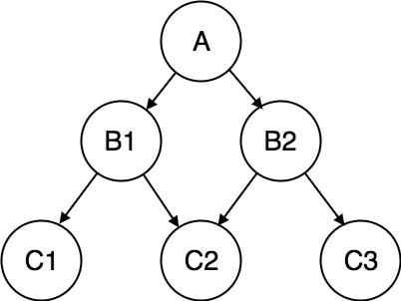
Network Model

Slide 12
Network Model
In the relational model the data and the relationships among data are represented by a collection of tables. The network model differs from the relational model in which data are represented by collection of records and relationships among data are represented by links.

Slide 13
Network Model
Network database
It consists of a collection of records connected to one another through links. A record is in many respects similar to an entity in the ER model. Each record is a collection of attributes, each of which contain only one data value.
Data-Structure Diagrams
A data-structure diagram is a schema representing the design of a network database.
Such a diagram consists of two basic components:
1. Boxes, which correspond to record types
2. Lines, which correspond to links
A data-structure diagram serves the same purpose as an E-R diagram; namely, it specifies the overall logical structure of the database. So that you will understand how such diagrams are structured, we shall show how to transform E-R diagrams into their corresponding data-structure diagrams

Slide 14
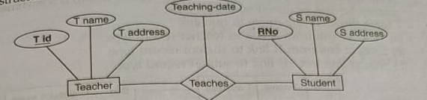
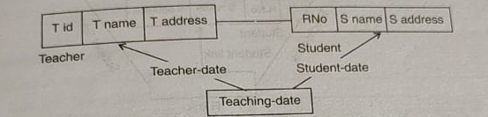
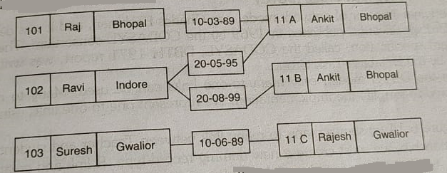
Network Model

Slide 15
Advantages
Simple Concept: Similar to the hierarchical model, this model is simple and the implementation is effortless.
Ability to Manage More Relationship Types: The network model has the ability to manage one-to-one (1:1) as well as many-to-many (N: N) relationships.
Easy Access to Data: Accessing the data is simpler when compared to the hierarchical model.
Data Integrity: In a network model, there's always a connection between the parent and the child segments because it depends on the parent-child relationship.
Data Independence: Data independence is better in network models as opposed to the hierarchical models.

Slide 16
Disadvantages
System Complexity: Each and every record has to be maintained with the help of pointers, which makes the database structure more complex.
Functional Flaws: Because a great number of pointers is essential, insertion, updates, and deletion become more complex.
Lack of Structural Independence: A change in structure demands a change in the application as well, which leads to lack of structural independence.
Incomplete Flexibility: It is more flexible than the hierarchical model, the network one still cannot satisfy all relations by assigning another owner.

Slide 17
Hierarchical model
In hierarchical model, data is organized into a tree like structure with each record is having one parent record and many children. The main drawback of this model is that, it can have only one to many relationships between nodes.
Hierarchical models are rarely used now.

Slide 18
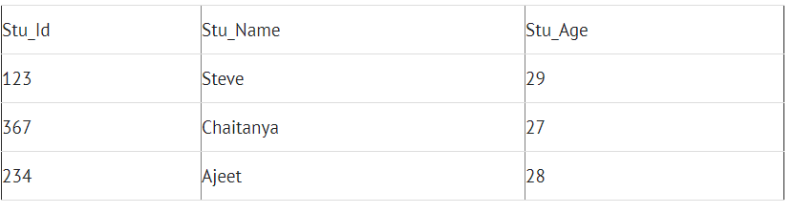
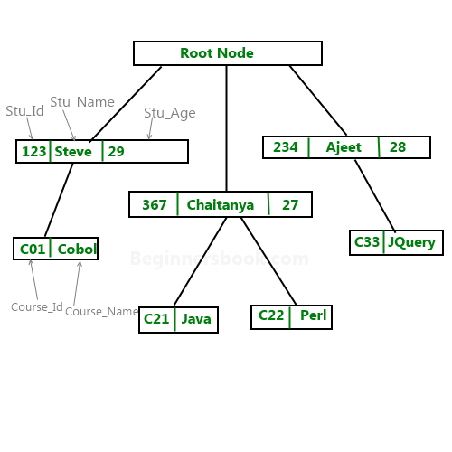
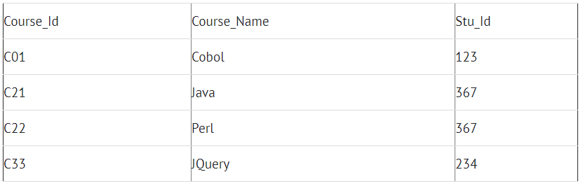
Hierarchical model
Lets say we have few students and few courses and a course can be assigned to a single student only, however a student take any number of courses so this relationship becomes one to many.

Slide 19
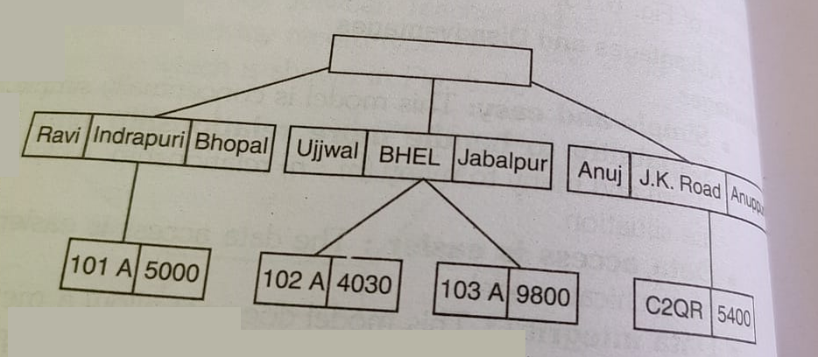
Hierarchical model
A hierarchical database consists of a collection of records that are connected to
each other through links. A record is similar to a record in the network model.
Each record is a collection of fields (attributes), each of which contains only one data value. A link is an association between precisely two records. Thus, a link here is similar to a link in the network model.

Slide 20
Advantages
Data can be retrieved easily due to the explicit links present between the table structures.
Referential integrity is always maintained i.e. any changes made in the parent table are automatically updated in a child table.
Promotes data sharing.
It is conceptually simple due to the parent-child relationship.
Database security is enforced.
Efficient with 1: N relationships.
A clear chain of command or authority.
Increases specialization.
High performance.
Clear results.

Slide 21
Disadvantages
If the parent table and child table are unrelated then adding a new entry in the child table is difficult because additional entry must be added in the parent table.
Complex relationships are not supported.
Redundancy which results in inaccurate information.
Change in structure leads to change in all application programs.
M: N relationship is not supported.
No data manipulation or data definition language.
Lack of standards.
Poor flexibility
Communication barriers
Organizational Disunity.
Rigid structure

Slide 22


